Slide 1

Cyberterrorism, Cyberwarfare and Cybercrime in the Age of AI
What the average citizen needs to know and can do
July 2025
James Province

Slide 2

Agenda
Introduction
Electronic Data Growth
Microsoft's Actions
Definitions
Cyberterrorism and Cyberwarfare
Cybercrime
AI
Preventing Cybercrime: What
should do
Additional Resources

Slide 3
James Province
Practiced law as a litigator for over 20 years
Started a small technology company that sold Tablet PCs to lawyers and judges to improve their productivity
Most recently ran the Risk & Compliance Team at a Microsoft Partner prior to joining Microsoft
Now works at Microsoft helping US Federal Agencies better understand digital risk and ways to mitigate that risk
BA: Westmont College, Montecito, CA.
Juris Doctor: University of Iowa, College of Law

Slide 4
Disclaimer
I am not speaking on behalf of Microsoft nor my US Federal Agency Customers. The opinions expressed are those of James himself.
Also, all information discussed in this presentation is publicly available and is not any “inside” information from Microsoft nor from any US Federal Agencies.

Slide 5
Electronic Data Growth

Slide 6

Data is EXPLODING in size and complexity
Some sobering statistics:
Data creation will grow to more than 181 zettabytes by 2025 vs 147 ZB in 2024. (Source: Genius)
80-90% of the data we generate today is unstructured. (Source: CIO)
1 zettabyte = 931,322,574,615.48 GB

Slide 7

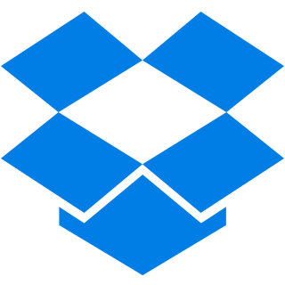
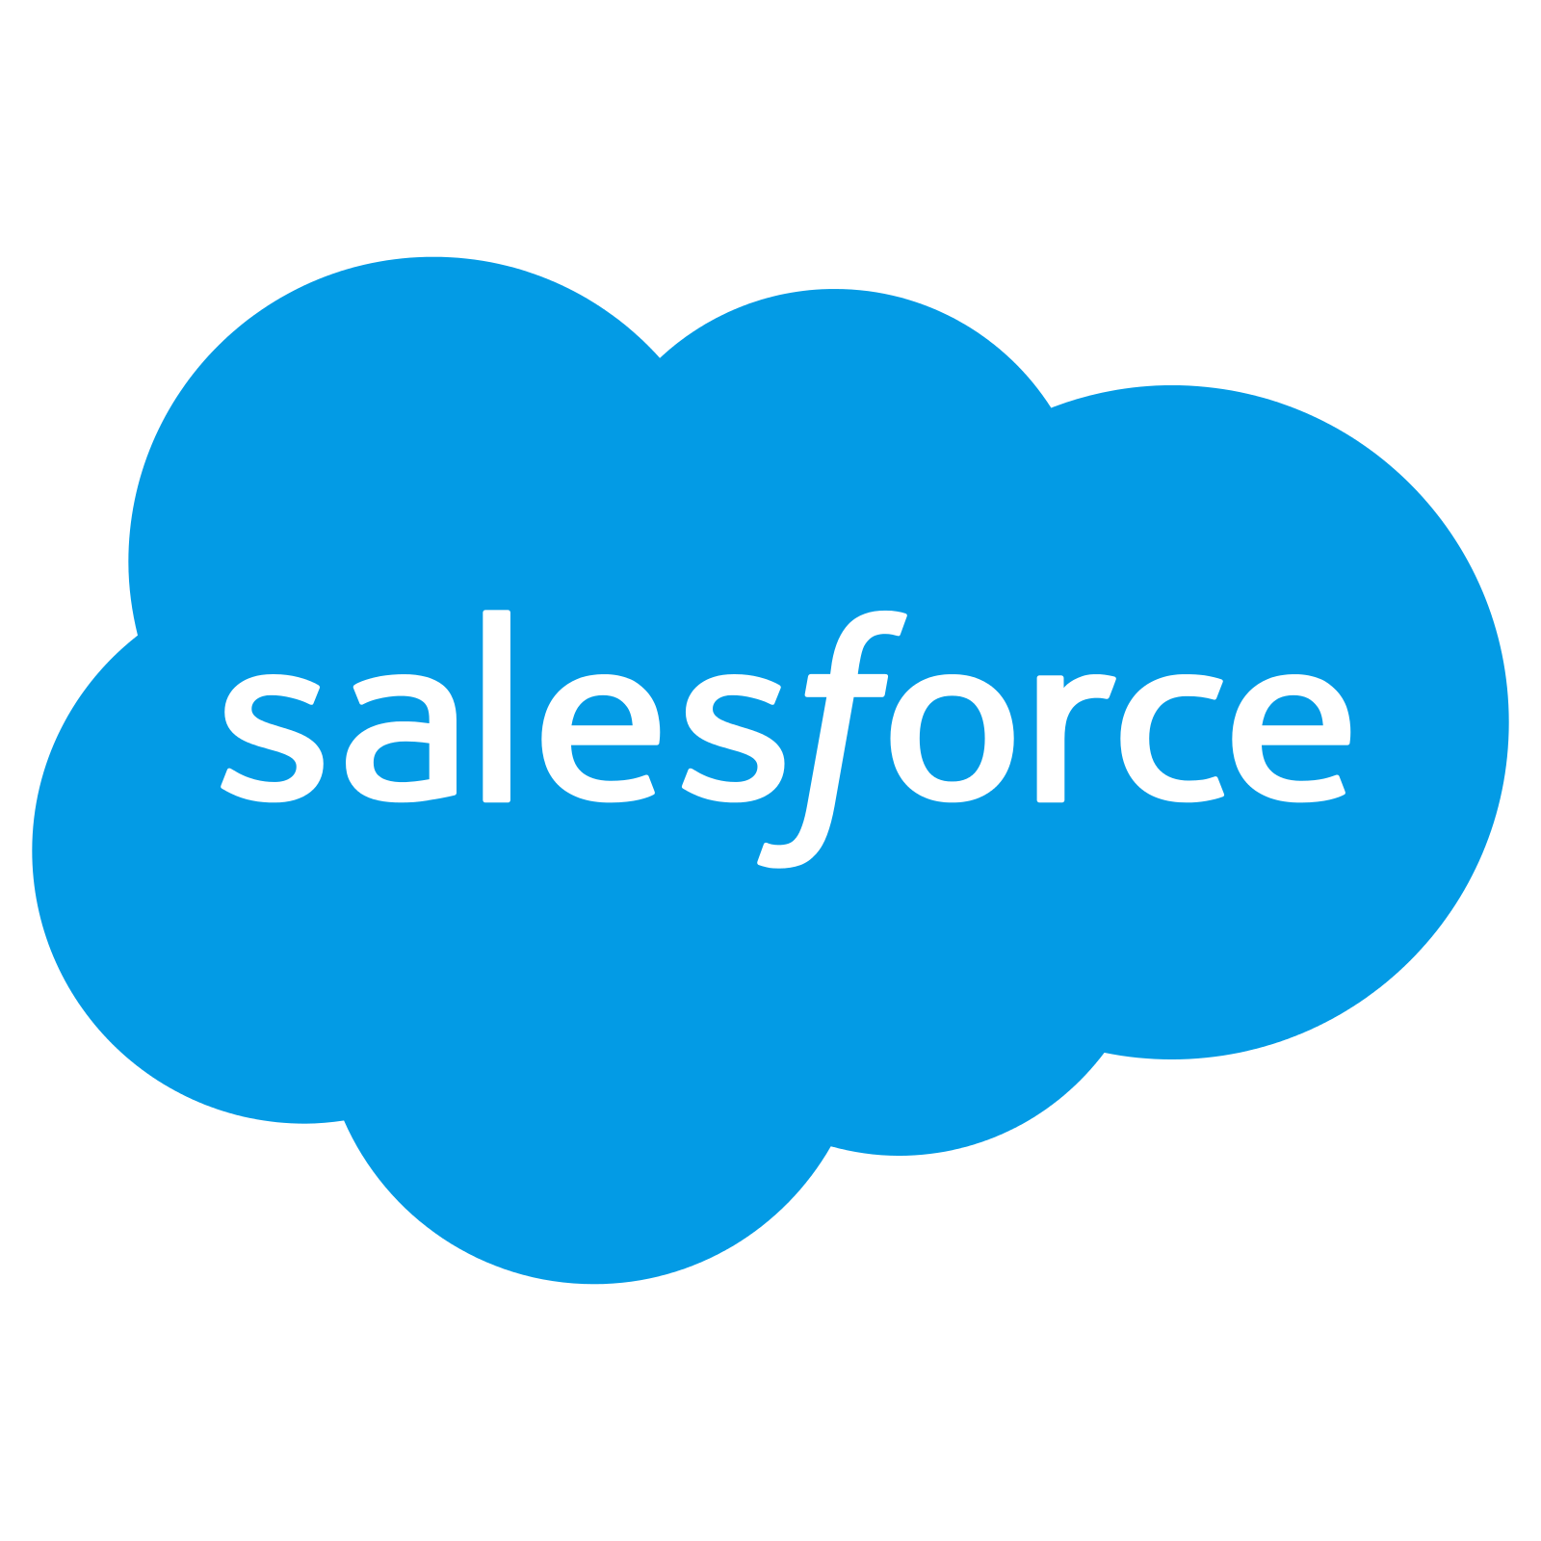

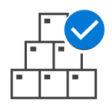




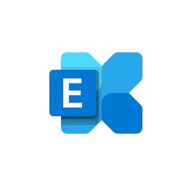

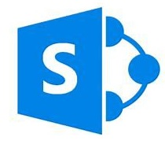
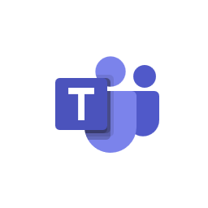

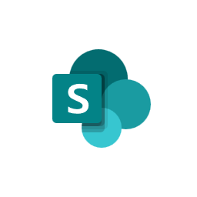








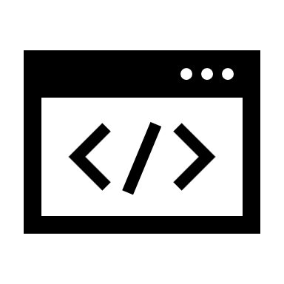



Think of Where YOUR Data Lives and How it is Transmitted
Windows
MacOS
iOS
Defender for Cloud Apps
Android
Office 365
On-premises
Microsoft Purview
data governance services
Endpoint DLP
ADLS
SQL DB
Azure Files
Cloud Upload
App Control
Blobs
Cosmos DB
S3
USB Drive
Network
Print
Clipboard
Bluetooth
RDP

Slide 8
Framing some thoughts on digital risks
This is SERIOUS

Slide 9
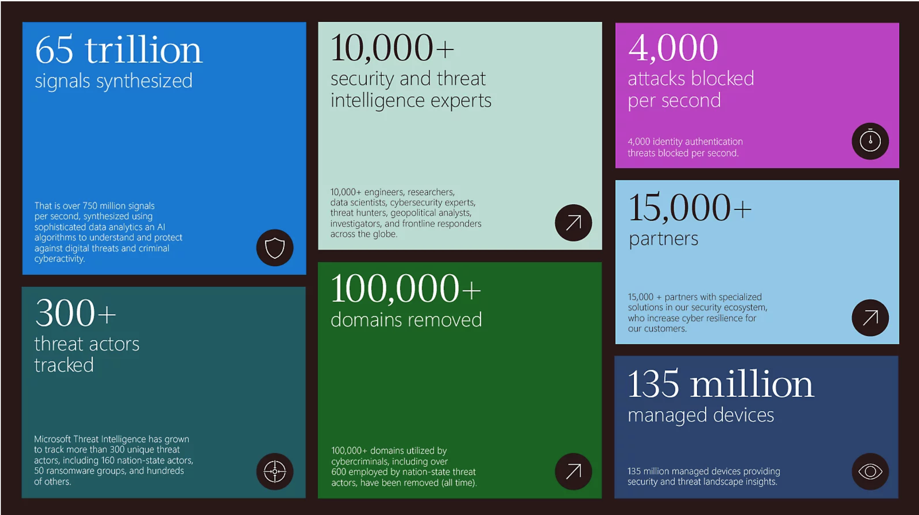




















Microsoft’s Actions

Slide 10
Definitions.

Slide 11
Cyberterrorism vs. Cyberwarfare vs. Cybercrime
Cybercrime is separate from Cyberterrorism and Cyberwarfare are three distinct concepts:
Cyberterrorism is the use of digital technologies to carry out terrorist attacks or to spread fear and panic among the public. Cyberterrorism can include activities such as hacking into government systems, disrupting critical infrastructure, and spreading propaganda online. Cyberterrorism is focused on causing harm to individuals or society as a whole. Cyberterrorism means conduct involving computer or Internet technology that (1) is motivated by a political, religious or ideological cause, (2) is intended to intimidate a government or a section of the public to varying degrees, and (3) seriously interferes with government functioning and/or critical infrastructure.**
Cyberwarfare is the use of cyber attacks from one state actor or delegate against an enemy state, causing comparable harm to actual warfare and/or disrupting vital computer systems. Some intended outcomes could be espionage, sabotage, propaganda, manipulation or economic warfare. Actions from the US are both offensive and defensive.
Cybercrime refers to illegal activities that are committed using the internet or other digital technologies. These activities can include hacking, identity theft, phishing, and other forms of online fraud. Cybercrime is focused on financial gain or other illegal activities.
It is important to note that all are serious issues that require attention from governments, businesses, and individuals alike.

Slide 12
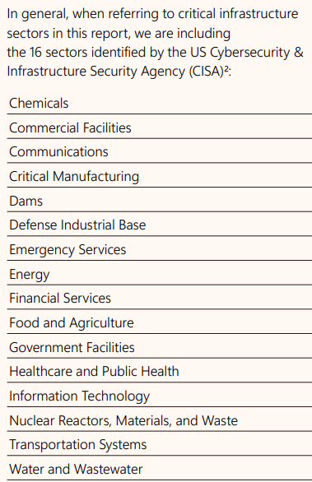
Cyberterrorism vs. Cyberwarfare vs. Cybercrime
**A note about Critical Infrastructure:
The US Government generally defines Critical Infrastructure systems and assets, whether physical or virtual, so vital to the United States that the incapacity or destruction of such systems and assets would have a debilitating impact on security, national economic security, national public health or safety. Further, Critical Information Infrastructure (CII) facilities use special equipment to control or manage telecommunications, air transportation, the financial sector, the electric power grid and many other services important for the economy and daily activity. Cyberattacks against these and other critical infrastructure facilities can potentially disrupt services over widespread areas and significant periods of time.

Slide 13
Account
You
Your Bank
FDIC/Federal Reserve/Banking System

Slide 14
Cyberterrorism and Cyberwarfare

Slide 15
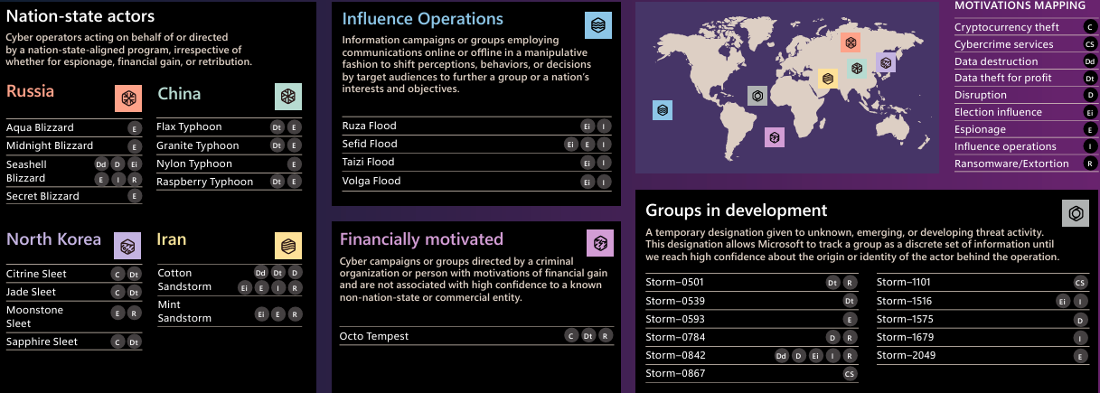

Slide 16
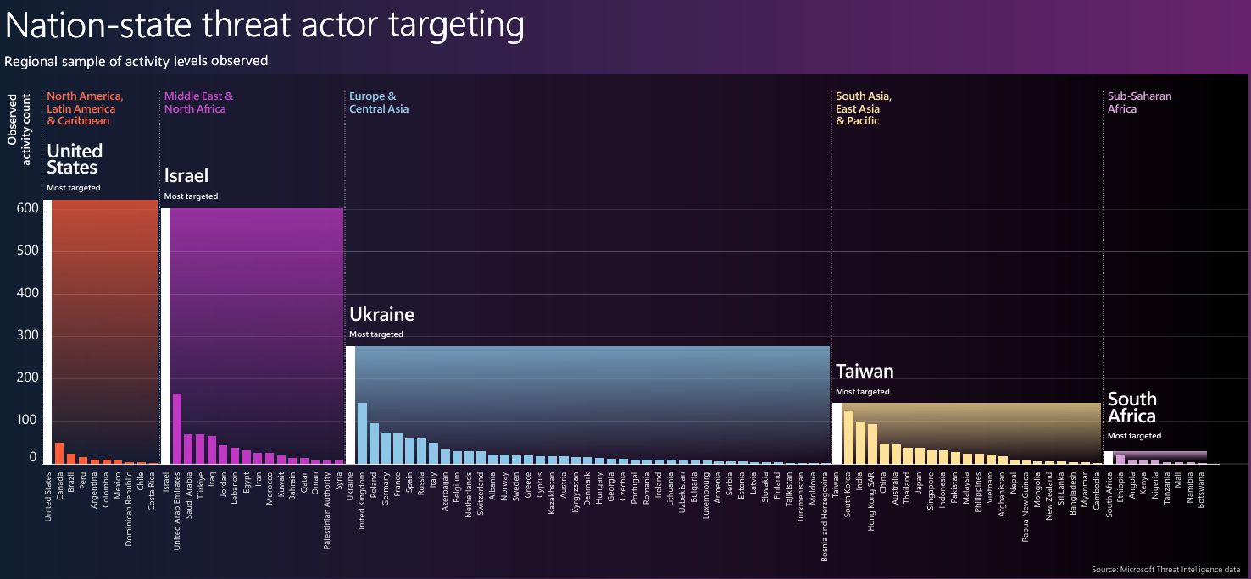
Which countries?

Slide 17
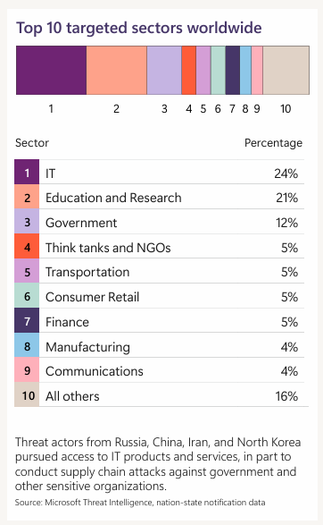

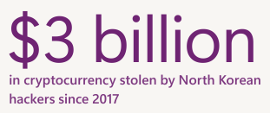
Blurring lines between nation-state threat actors and cybercriminals

Slide 18
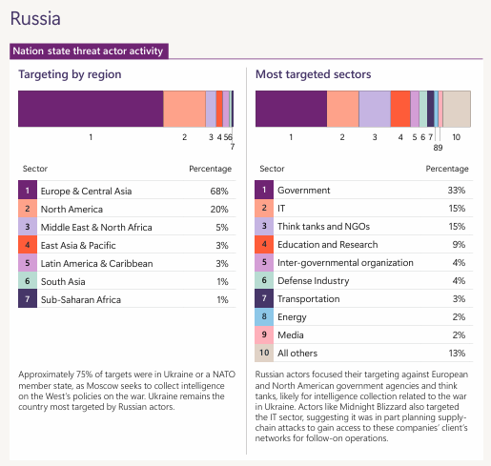

Slide 19
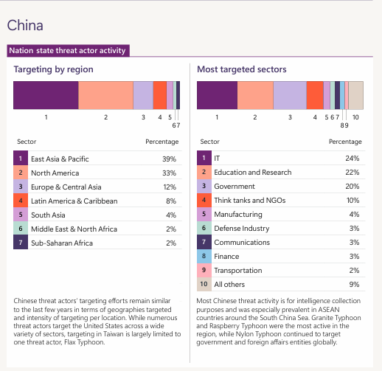

Slide 20
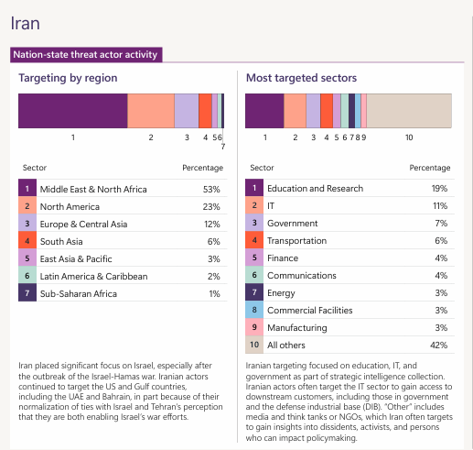

Slide 21
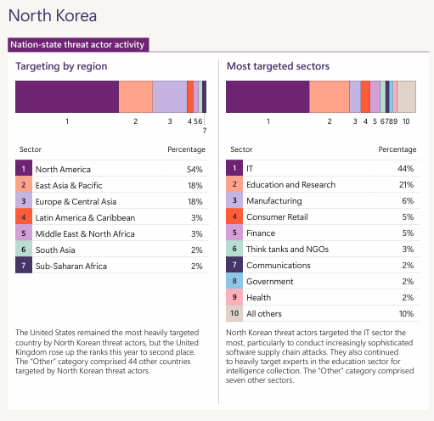

Slide 22
Cybercrime

Slide 23

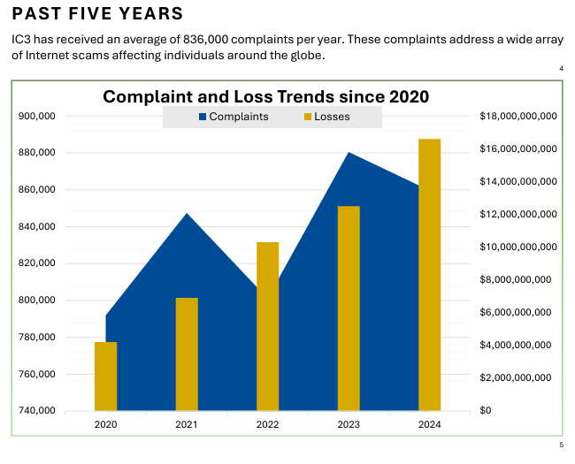
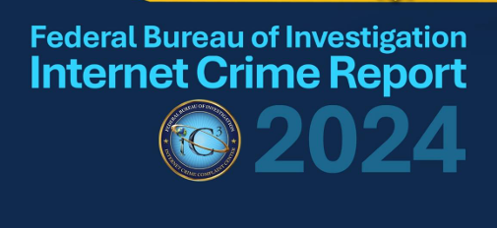

Slide 24
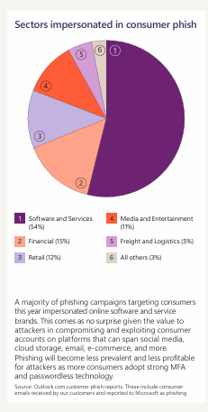
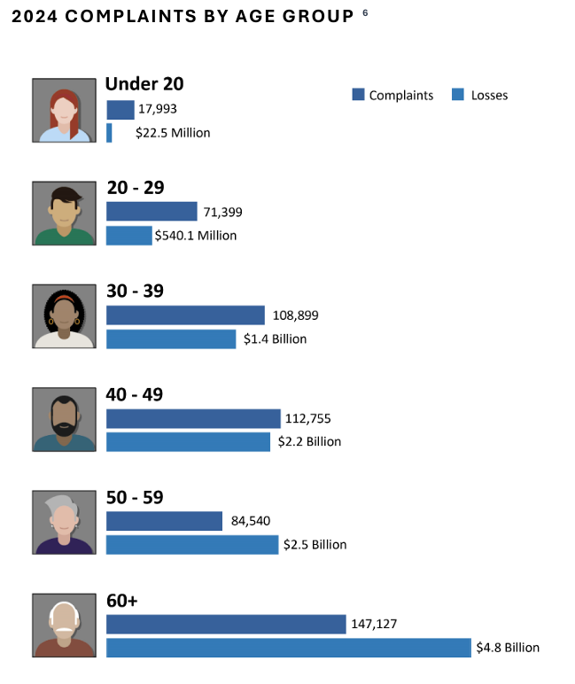
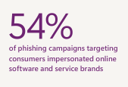

Slide 25
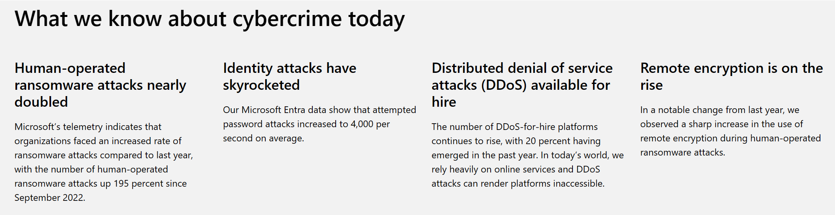
43% of Small Businesses experienced a cyberattack in the 2024.
Median payment for Small Businesses that faced Ransomeware attacks was $115,000 in 2024.

Slide 26
Password attacks

Slide 27

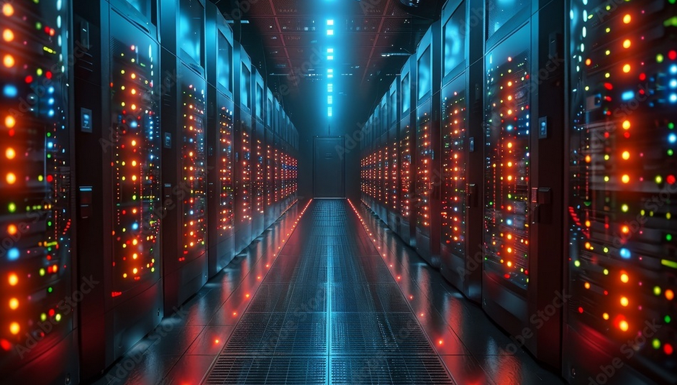
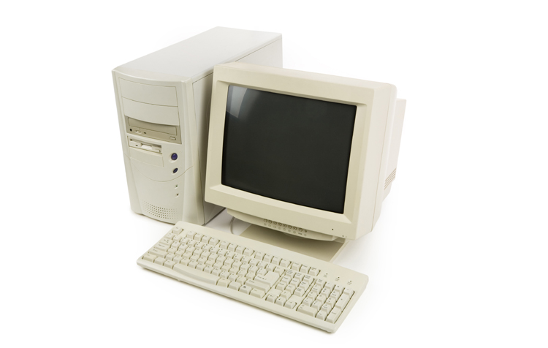








(A Pentium 100 can try 10,000 passwords a second. A supercomputer can try 1,000,000,000 per second).
Brute Force Attack

Slide 28
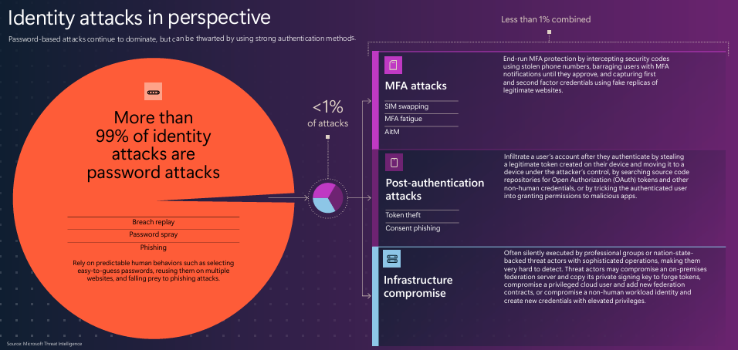
Microsoft Entra data shows that of more than 600 million identity attacks per day, more than 99% are password-based. Advances such as default security configurations and Conditional Access policies have helped more organizations embrace multifactor authentication (MFA), increasing adoption to 41% among Microsoft enterprise customers.

Slide 29
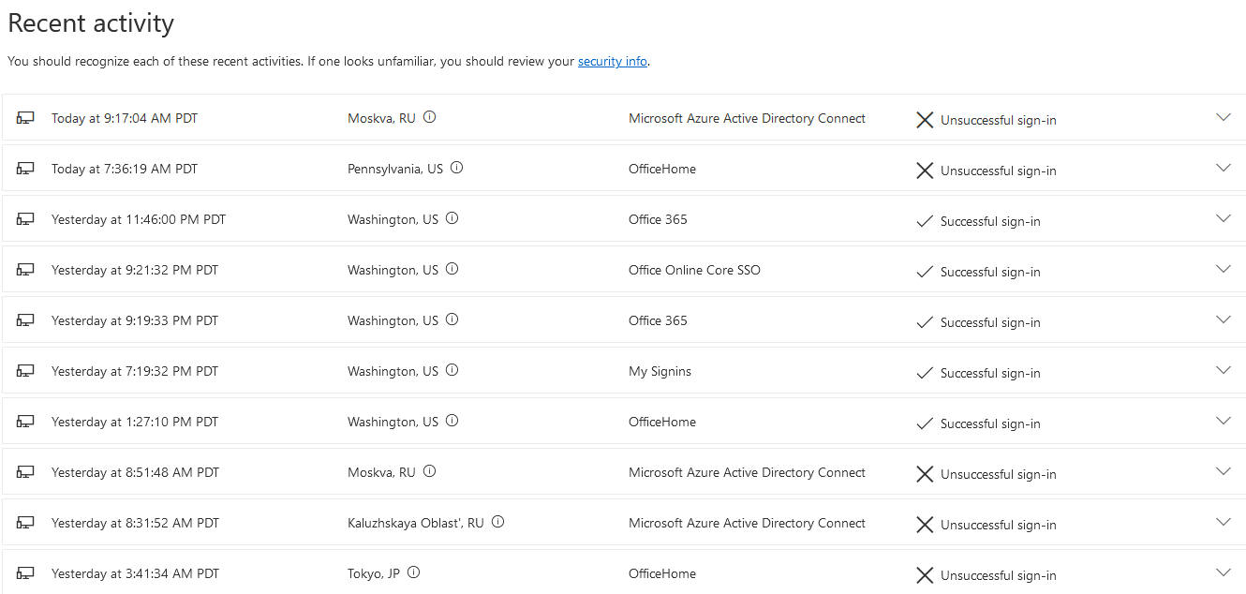














Slide 30
Ransomware

Slide 31
Ransomware:
Ransomware is a type of cryptovirological malware that permanently block access to the victim's personal data unless a ransom is paid. While some simple ransomware may lock the system without damaging any files, more advanced malware uses a technique called cryptoviral extortion.

Slide 32
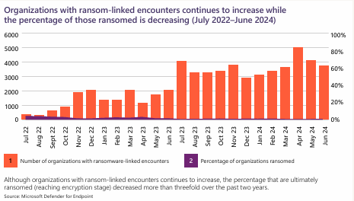

Slide 33
AI

Slide 34
AI:
Hackers now leverage AI to craft more believable scams, automate attacks, and even impersonate trusted people, putting everyone from home users to Main Street businesses at risk.

Slide 35
AI is a double-edged sword in cybersecurity.
On one hand, it helps build better defenses; on the other, it gives cybercriminals powerful new tools. Recent trends show that attackers are using AI to make their attacks faster, smarter, and harder to detect.
Here are the key AI-driven developments that the average person and small business owner should know about:
Generative AI Enables Convincing Scams: Modern “generative” AI (like advanced chatbots and content generators) can produce very human-like text, audio, and video. Criminals use these tools to automate the creation of phishing emails, fake websites, malware code, and more. Tasks that once required a lot of skill – such as writing malicious programs or crafting a believable scam email – can now be done in minutes by anyone with AI access. This means more attackers, even low-skilled ones, can launch attacks. For example, AI-written phishing messages mimic the tone and writing style of real people, making scam emails or texts look legitimate and personal. Some malicious chatbots even “chat” with you in real-time, adapting their responses to fool you into trusting them.

Slide 36
Deepfake Impersonations Erode Trust: Deepfakes – AI-generated fake videos or audio recordings that look and sound real – have moved beyond novelty into tools for fraud. Attackers can clone a person’s voice or image to impersonate them with alarming accuracy. In the business world, there are cases of CEO voice deepfakes being used to trick employees into transferring money, a scam that first made headlines in 2019. Today, this threat has grown: a recent 2025 report shows a 223% rise in deepfake tools on dark web forums (Q1 2023 to Q1 2024), and over half of security leaders now see deepfakes as a significant threat. Executives have been impersonated in live video meetings and phone calls, and even hiring processes have been infiltrated by fake candidates using AI-generated voices or faces. For individuals, deepfake technology means you could receive a call or video that appears to be from a family member in distress or a trusted official – when in fact it’s a criminal in disguise. In a world where “seeing (or hearing) is no longer believing,” we all have to verify identities through secondary means for sensitive requests.

Slide 37
AI-Powered Attacks Are Harder to Detect: Because AI allows threats to mimic human behavior, malicious activities blend in with normal events more than before. Phishing emails free of typos and perfectly tailored to you don’t set off alarm bells the way obvious spam used to. Likewise, malware tweaked by AI can be polymorphic (changing itself) to evade antivirus software. 42% of organizations reported falling victim to a social engineering attack in the past year, and many cite AI-enhanced phishing as a key factor. 47% of companies say deepfake-style impersonation is now their number one concern with generative AI, because these attacks can fool even cautious users. In short, AI is raising the quality of attacks, making them more believable and potentially more successful.
More Data Exposure and “Shadow AI”: Not all AI-related risk comes from criminals – sometimes it’s a side effect of well-intentioned use of AI tools. Generative AI systems train on vast datasets and sometimes regurgitate pieces of sensitive data that were in their training material. There’s also the risk of employees (or individuals) unwittingly sharing private info with AI services. In one survey, 22% of organizations were most worried about data leaks from employees using generative AI tools without proper guidance. For example, an employee might paste a customer’s data into a chatbot to get help, not realizing that data could be retained or later output by the AI. Small businesses should ensure they set policies on approved AI tools and train their staff to not share confidential data with public AI services.

Slide 38
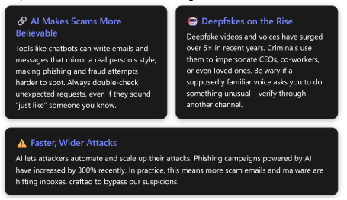
Attackers are also using AI to scan the internet for vulnerable systems at high speed. The 2025 Verizon Data Breach report notes that exploitation of known software vulnerabilities spiked dramatically – many criminals have effectively automated vulnerability scanning and attack launch as soon as a new weakness is disclosed. This puts pressure on everyone (especially businesses) to apply security updates quickly, as the window between a patch release and attacks is shrinking.
TL;DR:

Slide 39
What to do: Cyberterrorism and Cyberwarfare

Slide 40
For Cyberterrorism and Cyberwarfare:
Get Involved:
Push and question Government Agencies and Public/Private Infrastructure about what they are doing
Encourage them to get a strategy and act on risks
Prepare:
Cash in $20s
Gobag

Slide 41
Preventing Cybercrime

Slide 42
Preventing Cybercrime
Multifactor Authentication or Passwordless

Slide 43
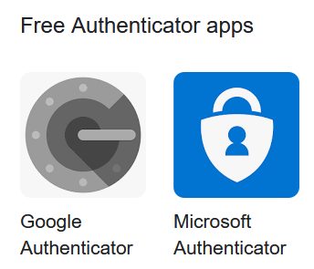
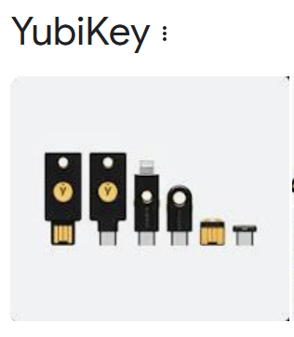

Slide 44
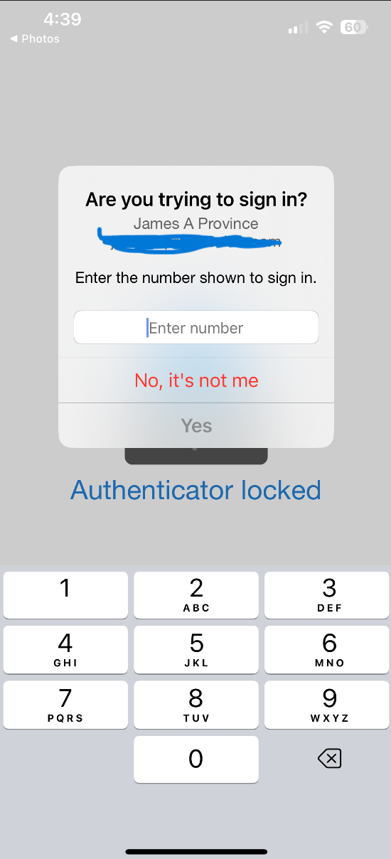
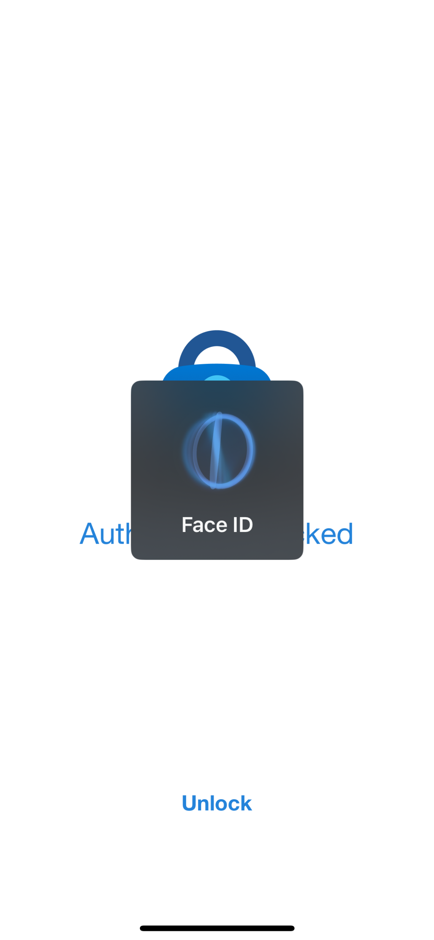
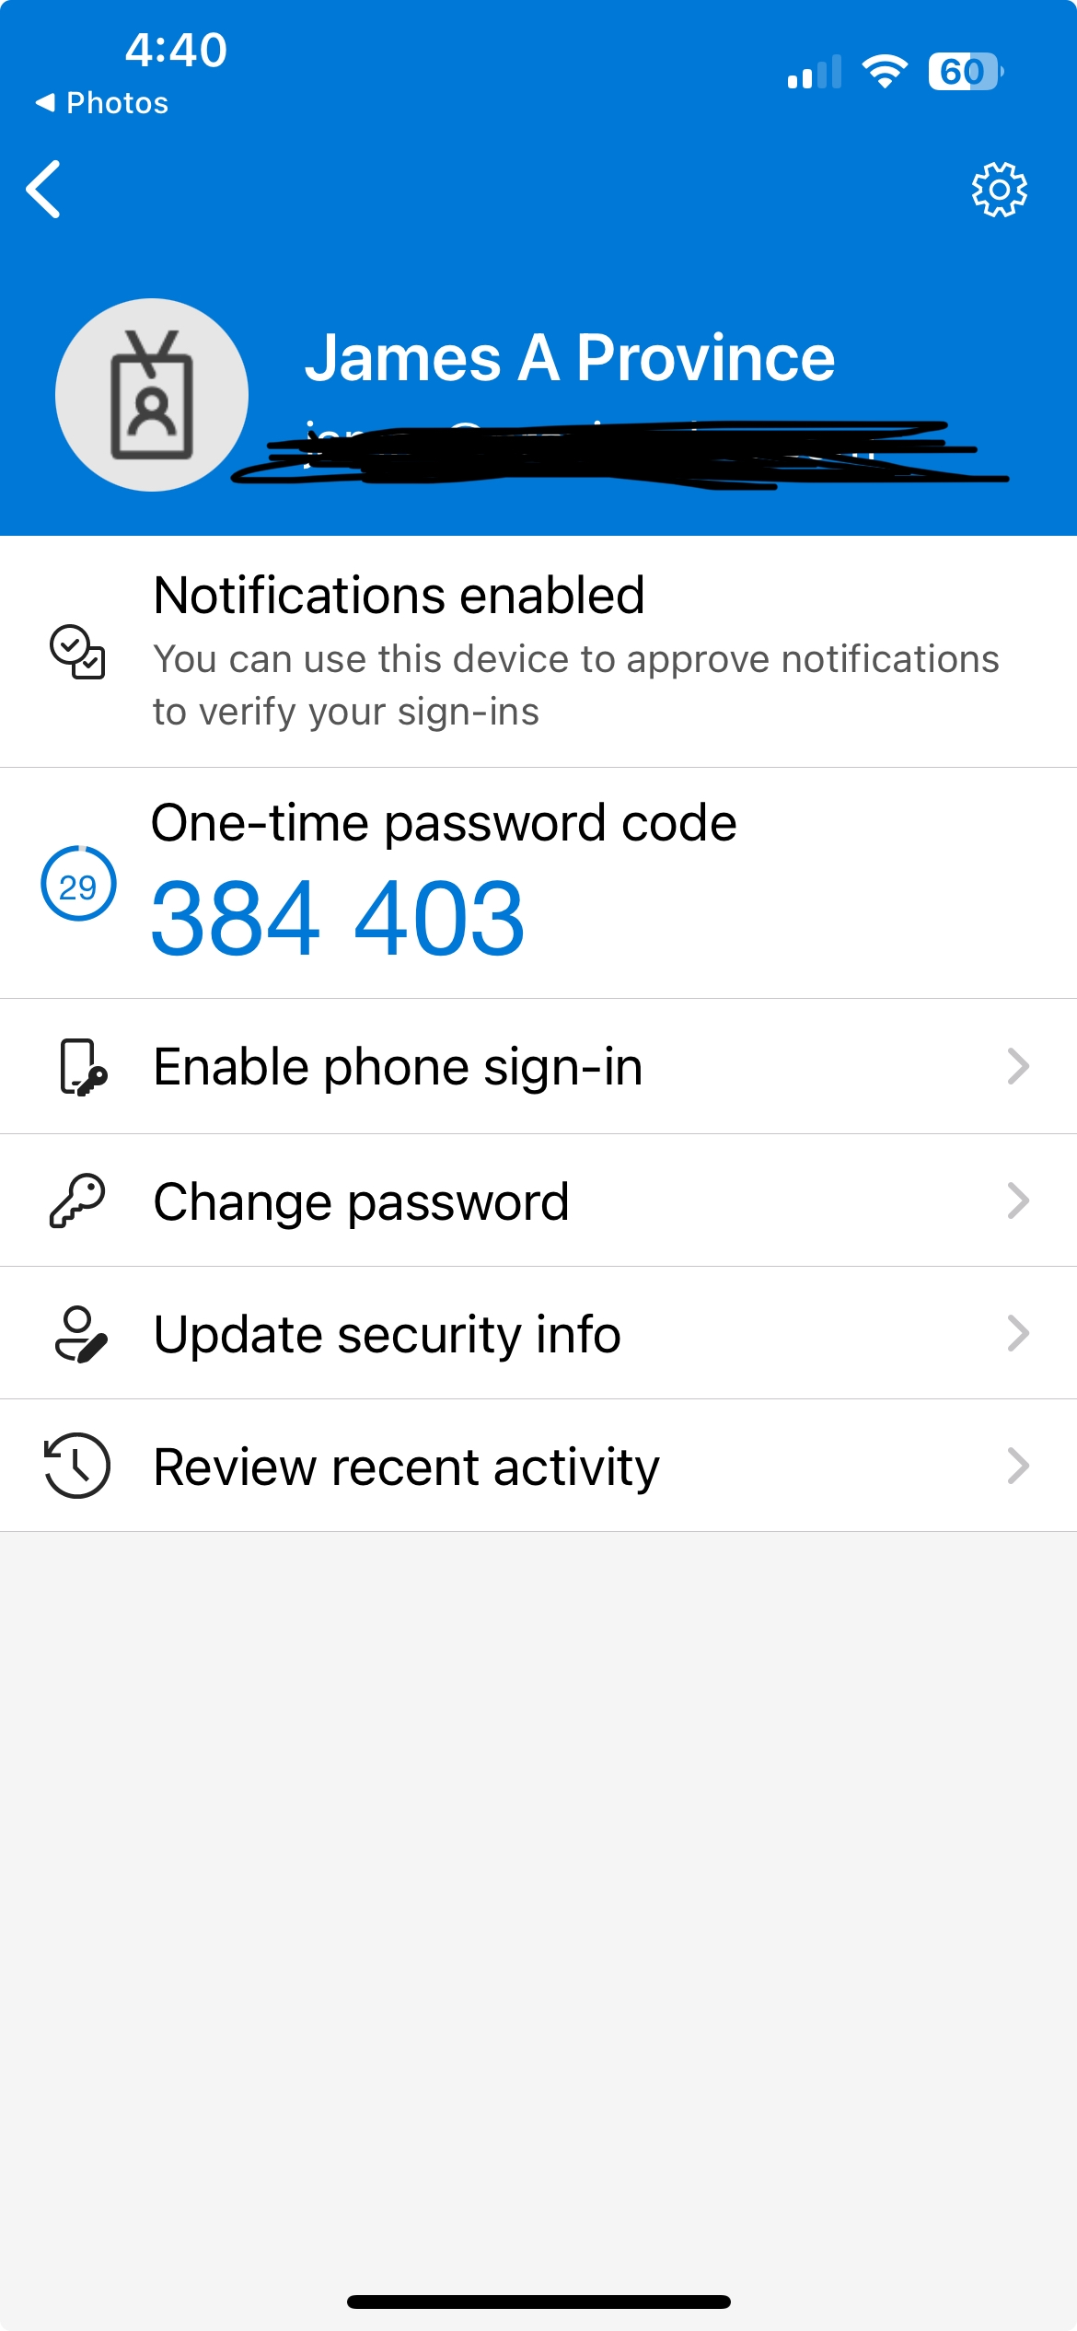

Slide 45
Preventing Cybercrime
Recognize phishing

Slide 46
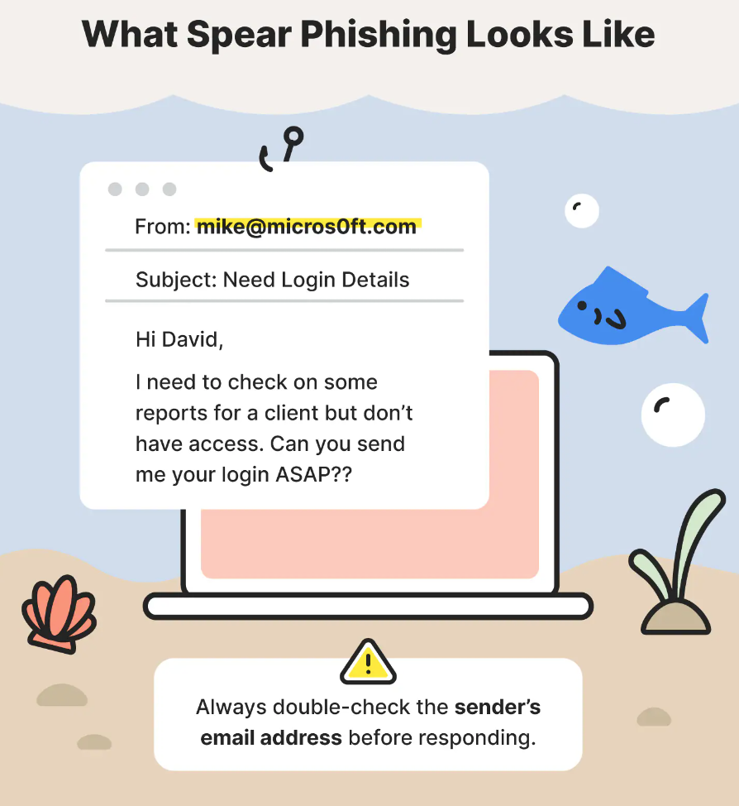

Slide 47
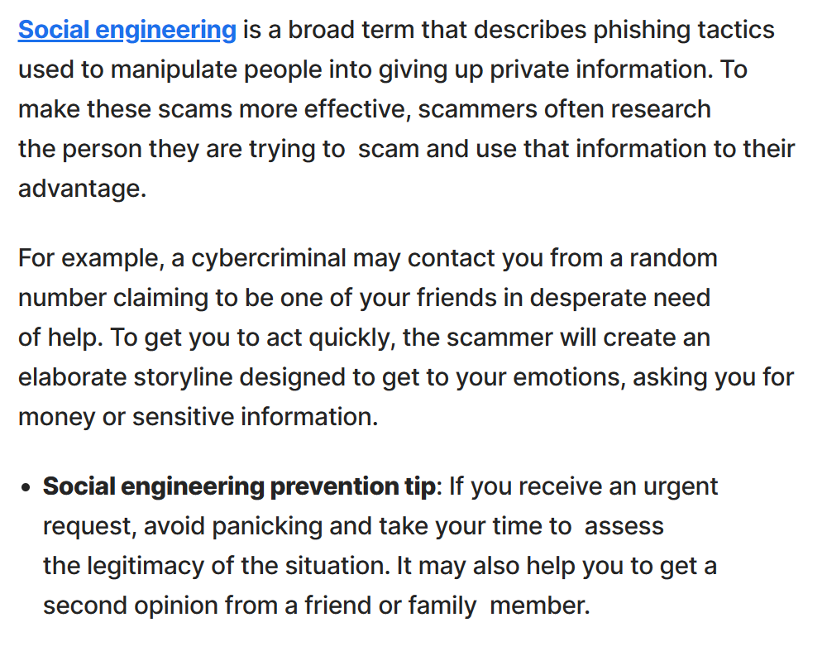

Slide 48
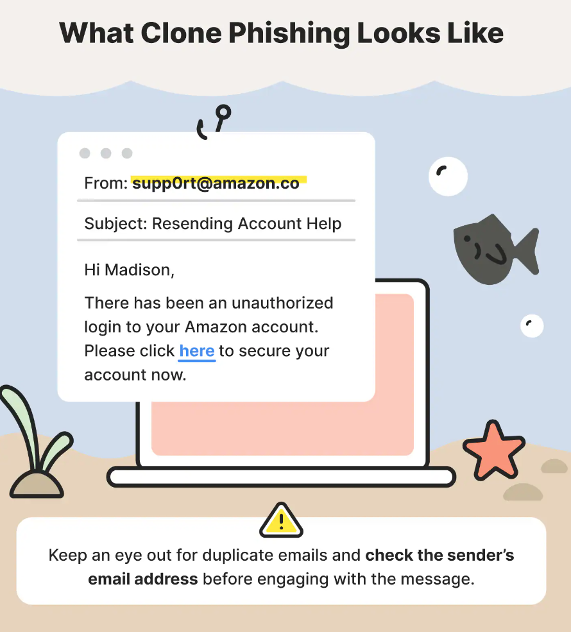

Slide 49
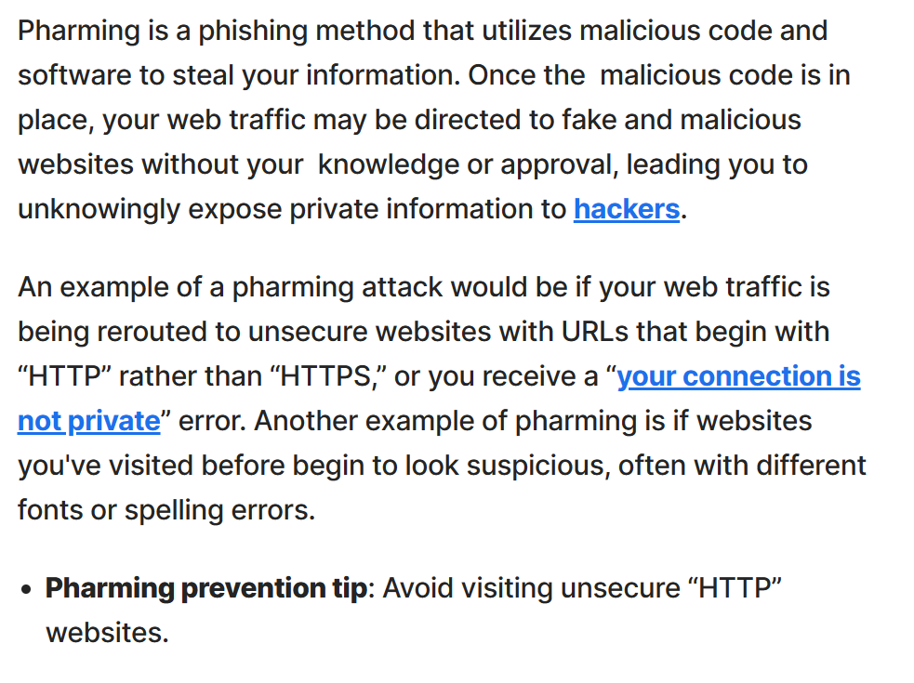

Slide 50
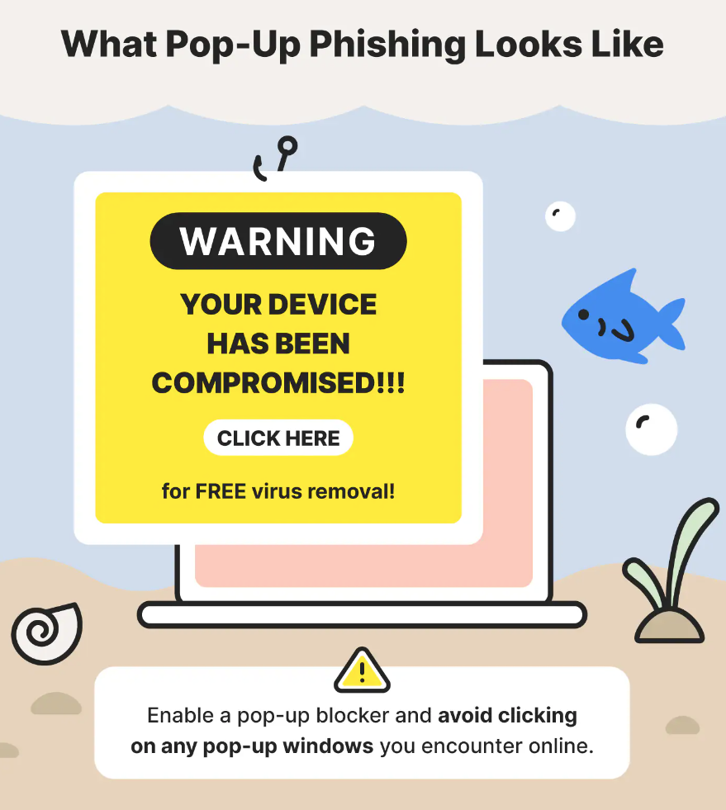

Slide 51
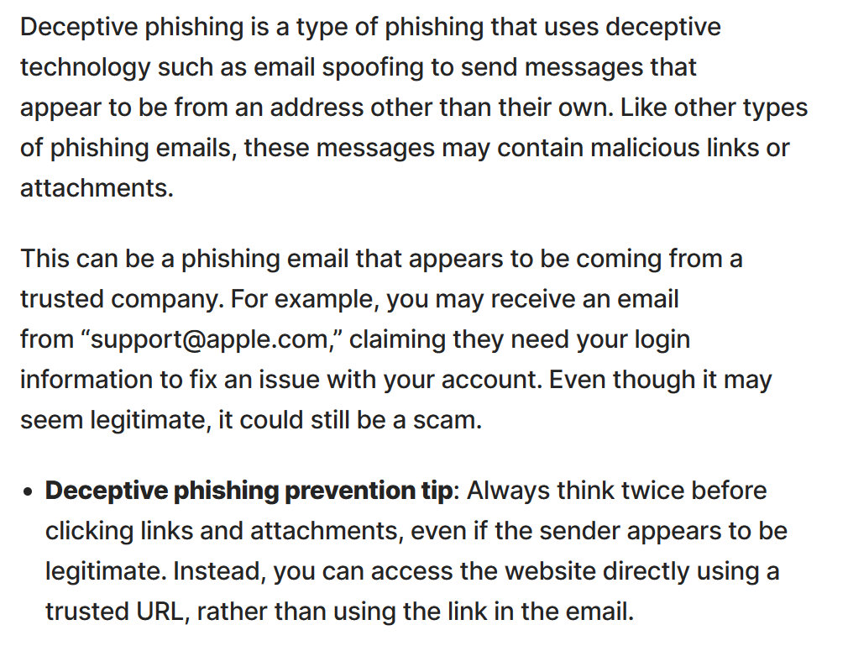

Slide 52
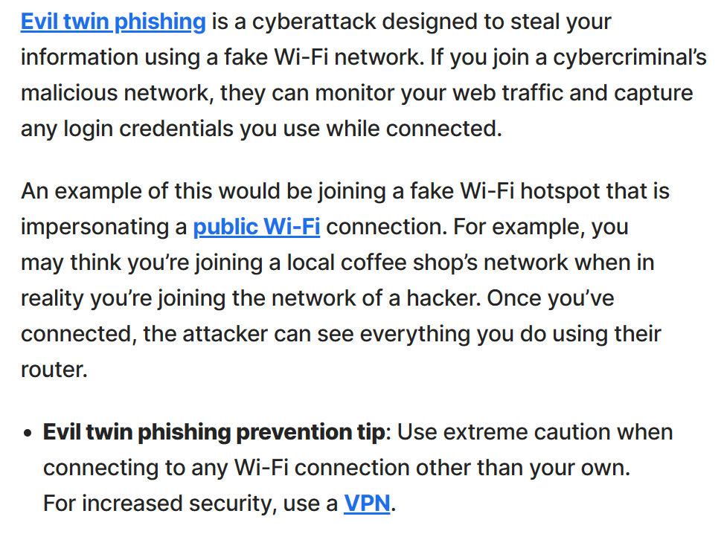

Slide 53
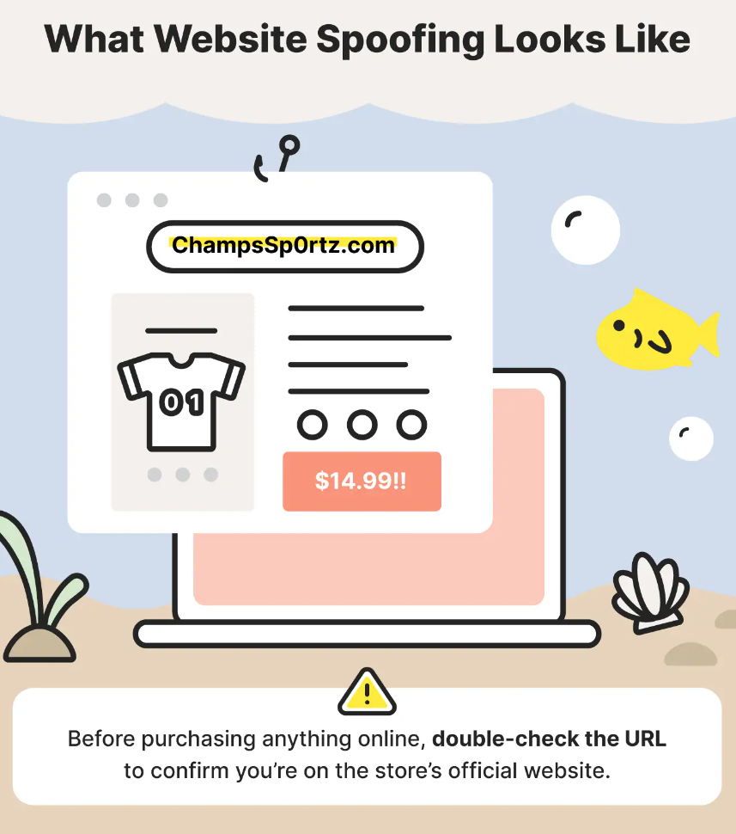

Slide 54
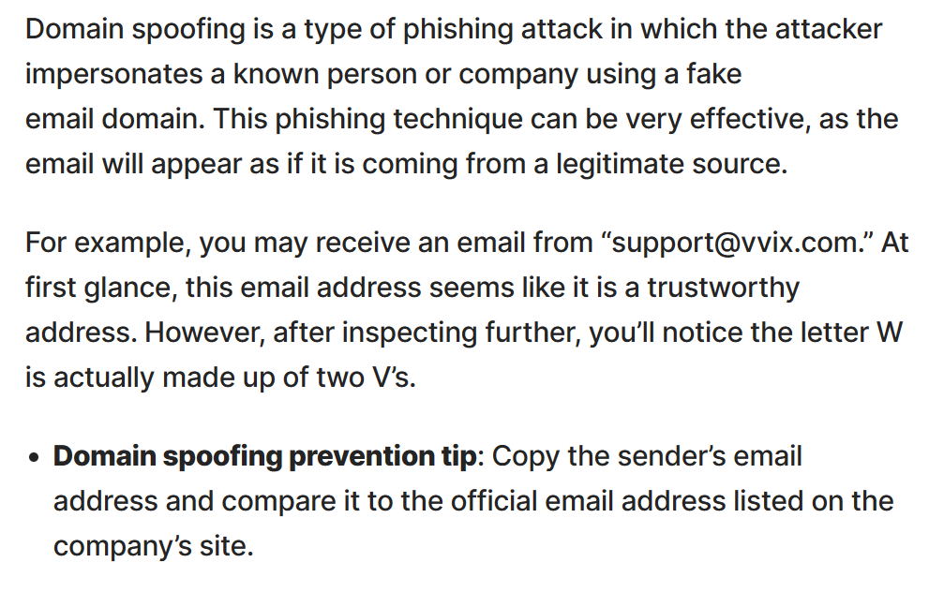

Slide 55
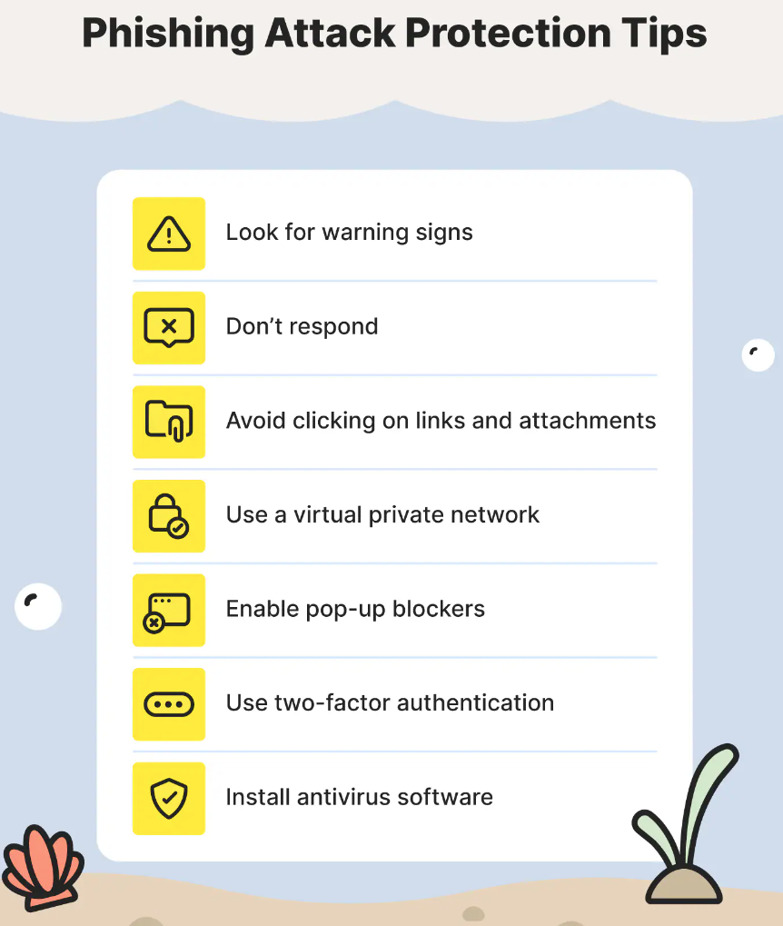











Slide 56
Preventing Cybercrime
Signs you may have been hacked

Slide 57
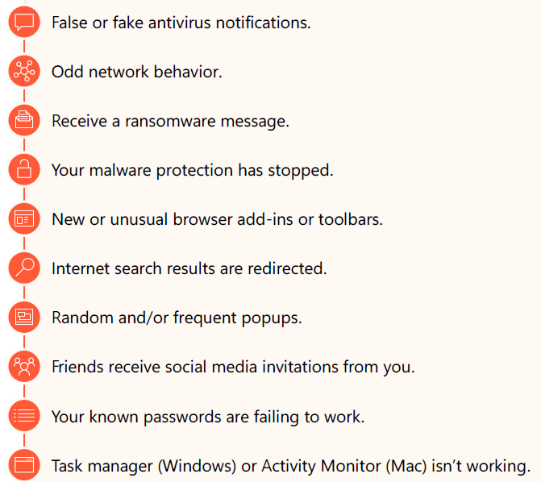
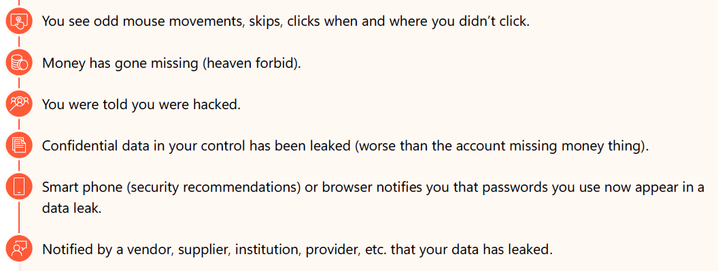

Slide 58
Preventing Cybercrime
Strategies and Actions to Prevent Nearly All Cybercrime

Slide 59
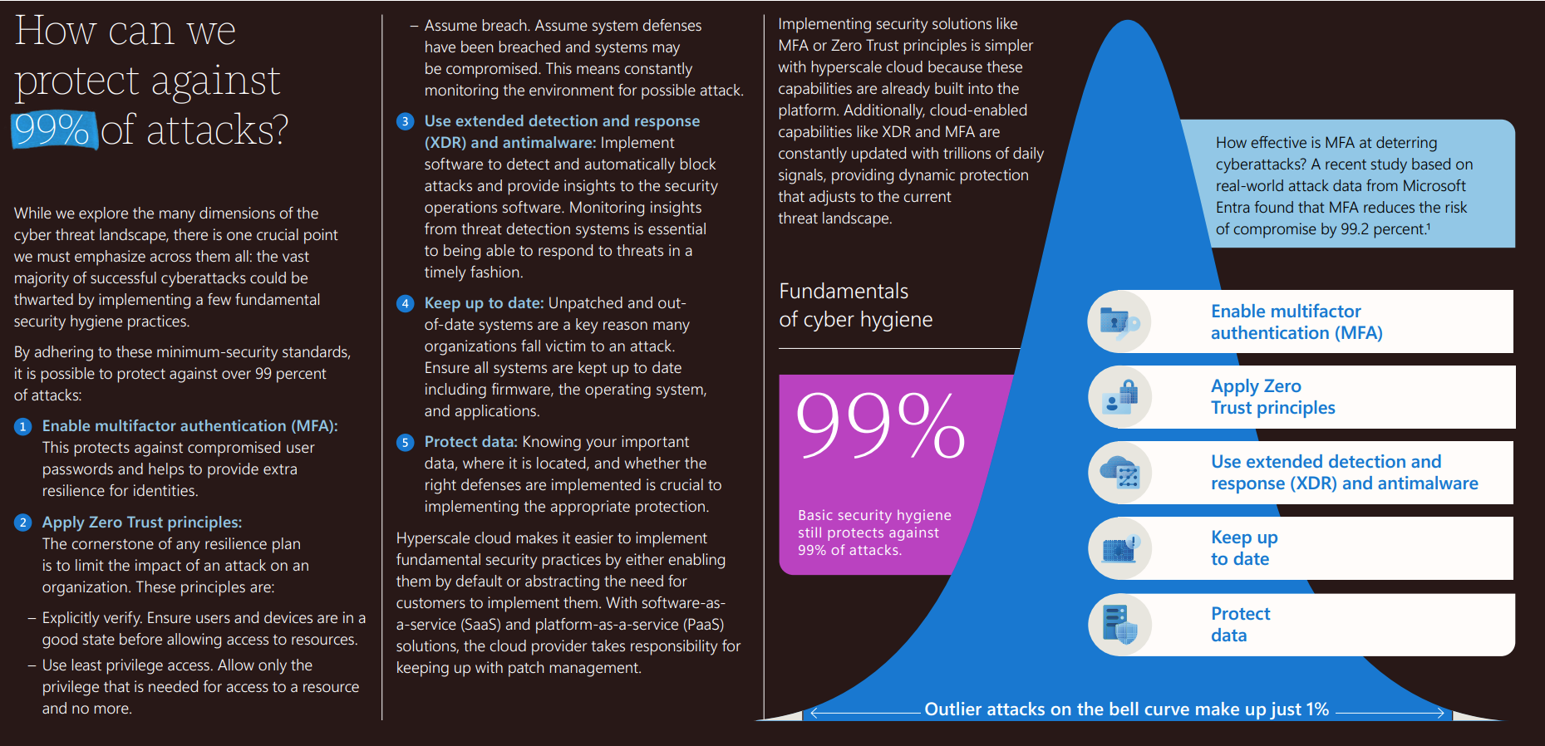

Slide 60
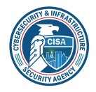
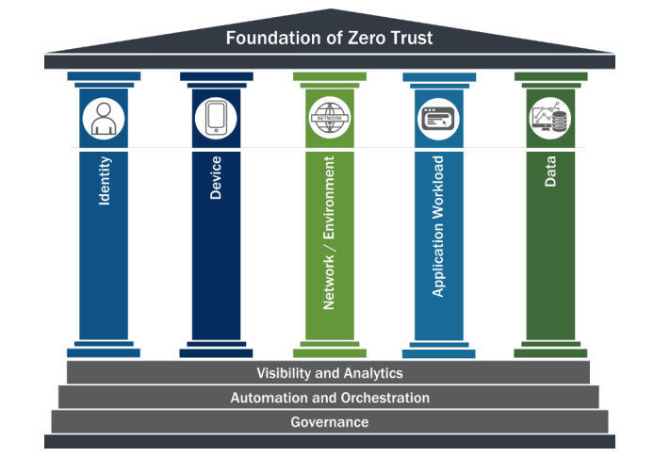
5 Pillar Zero Trust Maturity Model
LINK:
Zero Trust Maturity Model Version 2.0 (cisa.gov)

Slide 61


Slide 62
Best Practices for Individuals
• Use strong, unique passwords and enable multi-factor authentication.
• Keep software and systems updated.
• Be cautious of phishing emails and suspicious links.
• Use antivirus software and firewalls.

Slide 63
Best Practices for Small Businesses
• Conduct regular security audits and risk assessments.
• Train employees on cybersecurity awareness.
• Implement access controls and data encryption.
• Develop an incident response plan.

Slide 64
Additional Resource Links

Slide 65
Resource Guide
Setting Up Multifactor Authentication (MFA):
  What is: Multifactor Authentication - Microsoft Support
  Set up the Microsoft Authenticator app as your verification method - Microsoft Support
  Add non-Microsoft accounts to the Microsoft Authenticator app - Microsoft Support
Consider Passwordless:
  How to go passwordless with your Microsoft account - Microsoft Support
  https://www.yubico.com/
Ransomware:
  3 ways to protect yourself and your small business
  Quickly protect your organization against ransomware attacks
  Backup and restore plan to protect against ransomware
Zero Trust for Small Businesses:
  Small business Zero Trust guidance | Microsoft Learn
  Zero Trust deployment plan with Microsoft 365 | Microsoft Learn

Slide 66
THANK YOU!

